Slide 1

Group 14 Treatment as a Service (TaaS) Project Progress Presentation
Adhithya, Suraj, Kartikk, Chaitanya, Benjamin

Slide 2
Existing Problem
Non-adherence to prescribed treatment
Rates as high as 50%
Cost of non-adherence
More than 290 billion USD spent each year
13% of the total money spent on health care
https://youtu.be/-5k7vjRwLOY?list=LLWj01aJIN_XgDqgMJs8ss6w

Slide 3
The Idea
Oral or written treatment advice into treatment schemas
Treatment as a service
Subscription based model
Extending health care to home
Scope of implementation
Tracking medication (sensors, mbed)
Tracking restricted food (beacons)
Tracking sleep (fitbit/sensors)
Report side effects if any
Treatment progress

Slide 4
Technologies Used
Android
Node JS
MQTT
HTML 5, Jquery, CSS, Bootstrap
MBED platform
Amazon Alexa, AWS Lambda

Slide 5
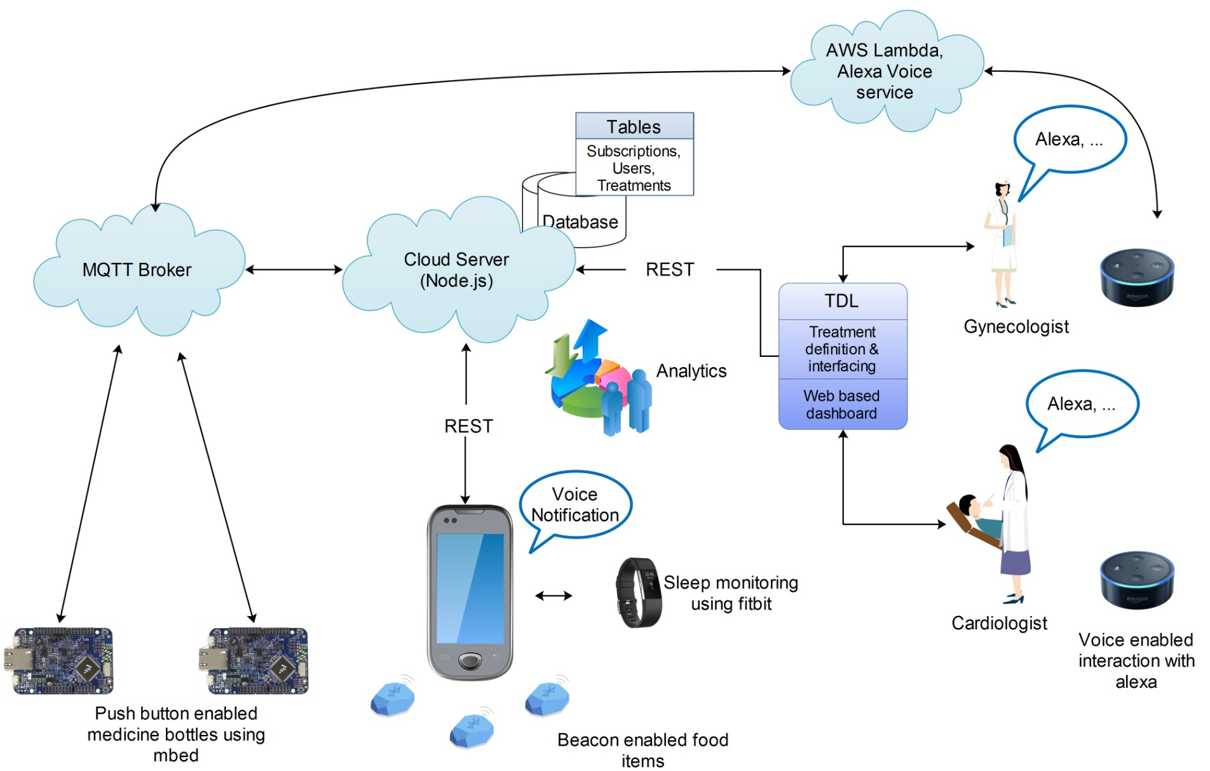
Architecture

Slide 6
Business Model
Cloud infrastructure and mobile app provided by Digital healthcare company
Treatment offered as a value added service by healthcare providers

Slide 7
Thank You

